Slide 1

Intelligence of Biological Systems -III
Batch A _ Group 13

Slide 2
Contributors
01
03
02
04
MOHITHA
AJAY SURYA
CB.EN.U4AIE21032
CB.EN.U4AIE21018
RAMA SARAN
SAI RAVULA
CB.EN.U4AIE21034
CB.EN.U4AIE21041

Slide 3
CONTENTS OF THIS PRESENTATION
Pre-requisites | All the terms that we will be using though out this presentation
Problems in string reconstruction | Why is string reconstruction hard
Overlap graphs and binary strings | Finding Hamiltonian path and k-universal strings
De Bruijn Graphs | Different ways of constructing de Bruijn graphs
Euler’s path | Seven bridges of Konigsberg, Eulers theorem, From Eulers path to Eulers cycle
Implementation | Python code for binary string and for a random sequence of data

Slide 4
PRE-REQUISITES
01
03
02
04
GENOME
GENOME SEQUENCING
Complete set of DNA in an organism
Determining the order of nucleotides in a genome
READS
GENOME ASSEMBLY
Shorter DNA fragments
process of putting a large number of short DNA sequences back together to recreate the original chromosomes from which the DNA originated

Slide 5
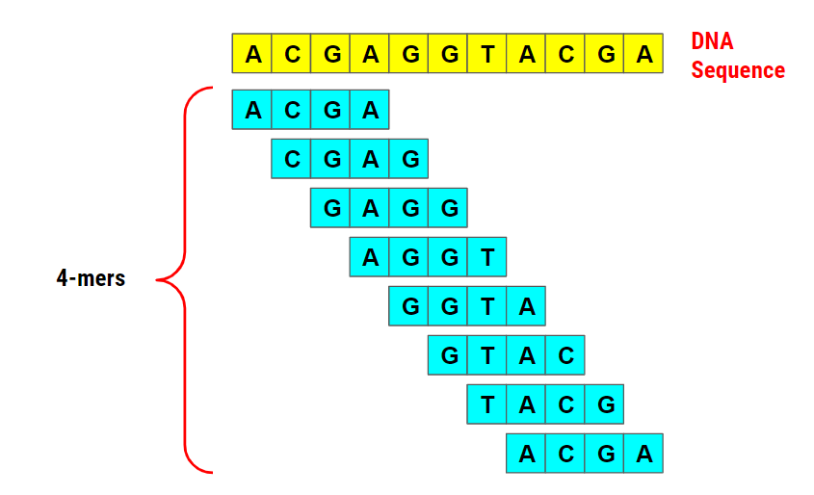
K-MERS
k-mers are substrings of length k in a given string (can be DNA, RNA, protein, or any string sequence).
“k-1-mer” refers to a substring of length k - 1

Slide 6
WHAT EXACTLY IS THE PROBLEM?
01
02
03
Genome Assembly is more harder than its appearing
From which strand
Errors
Gaps
DNA is double stranded, and we don’t know from which strand the read derives from
Modern sequencing machines are not perfect and they may generate errors
Some regions of the genome may not be covered by a reads
Throughout our presentation we will assume reads come from same strand, have no errors and exhibit perfect coverage , every k- mer substring is generated as a read

Slide 7
String Reconstruction Problem
Reconstruct a string from its k-mer composition
Input : An integer k and a collection Patterns of k-mers. Output : A string Text with k-mer composition equal to Patterns (if such a string exists).
Two ways of Solving String reconstruction problem
Either find Hamiltonian path in Overlap graph
Or find an Eularian path in the de-Bruijn graphs

Slide 8
Real world Assembly methods
OLC: Overlap-Layout-Consensus assembly
DBG: De Bruijn graph assembly

Slide 9
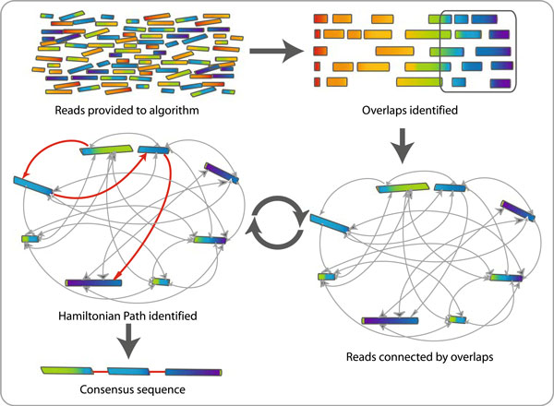
Overlap Graphs
Overlap–layout–consensus genome assembly algorithm: Reads are provided to the algorithm. Overlapping regions are identified. Each read is graphed as a node and the overlaps are represented as edges joining the two nodes involved. The algorithm determines the best path through the graph (Hamiltonian path). This process is carried out multiple times and resulting sequences are combined to give the final consensus sequence that represents the genome.

Slide 10
Lets peep into overlap graphs!
In genome sequencing we do not know in advance how to correctly order reads .
Therefore we will arrange the mers in lexicographical order which produces the overlap graph
Reconstruct a overlap graph from its k-mer composition
Input : An integer k and a collection Patterns of k-mers. Output : An overlap graph, OVERLAP(Patterns)

Slide 11
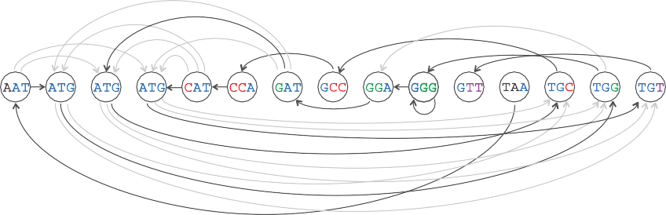
The original genome path, highlighted in the overlap graph. Solve the String Reconstruction Problem, we are looking for a path in the overlap graph that visits every node exactly once. In general, a path visiting every node once is called a Hamiltonian path, as shown in the figure below (a Hamiltonian path in the overlap graph).
A graph may have more than 1 Hamiltonian path

Slide 12
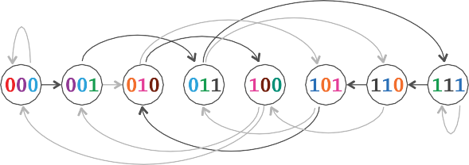
Origin of De-Bruijn Graphs
A binary string is a string composed of only 0’s and 1’s
A binary string is k-universal if it contains every binary k-mer exactly once
EX : 0001110100
Finding a k-universal is equivalent to finding a Hamiltonian path f in overlap graph formed on all binary k-mers

Slide 13
De-Bruijn Graphs
Another graph for string Reconstruction

Slide 14
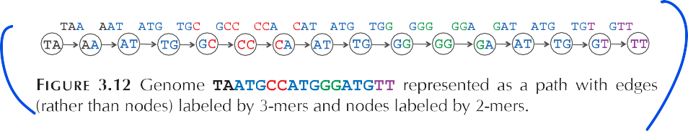
Assign 3-mers to edges
Nodes are 2-mers representing the overlapping nucleotides shared by the edges on either side of the node
Genome TAATGCCATGGGATGTT represented as a path with edges labelled by 3- mers and nodes labelled by 2-mers
Given a genome Text ,PATHGRAPHk(Text) is the path consisting of |text|-k+1 edges , where the i-th edge of this path is labelled by the i-th k-mer in Text and the i-th node of the path is labelled by the i-th (k-1)-mer in Text. The de Bruijn graph DEBRUIGNK(Text) is formed by gluing identically labelled nodes in PATHGRAPHk(Text)

Slide 15
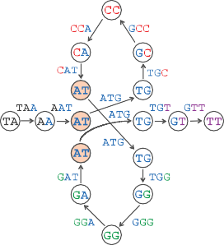
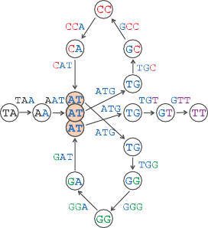
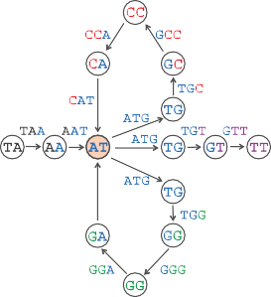
Gluing identically labelled nodes ( 3 AT, 3 TG and 2 GG)
Number of nodes reduced but number of edges remained the same

Slide 16
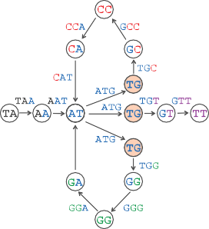
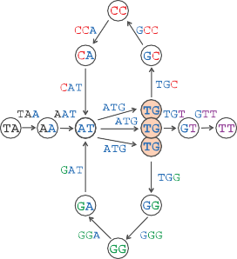
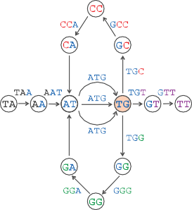
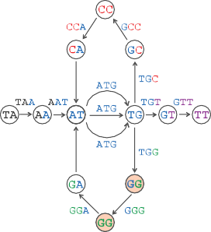
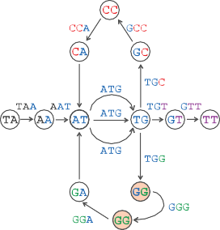
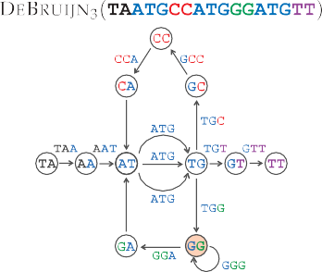

Slide 17
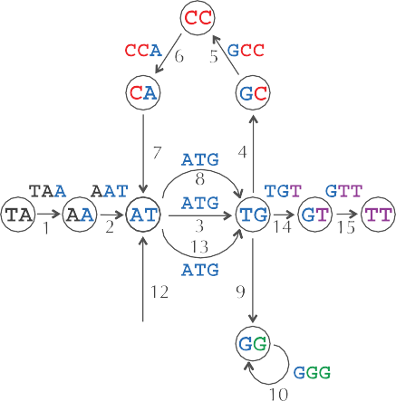
Eulerian path
Finding a path in the de- Bruijin graph that visits every edge exactly once
Constructing this graph requires us to know the correct ordering of k-mers in Text !

Slide 18

Another Way
We can construct the de bruijin graph from the genome 3-mer composition without knowing the genome !
Given an arbitrary collection of k-mer patterns we define COMPOSITIONGRAPH (Patterns) as a graph with |patterns| isolated edges
Every edge is labelled by k-mer from patterns, and the starting and ending nodes of an edge are labelled by the prefix and suffix of the k-mer labelling that edge.
We then define DEBRUIJIN(Patterns) by gluing identically labelled nodes in COMPOSITIONGRAPH (Patterns)

Slide 19
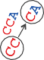
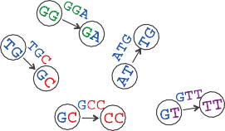
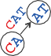
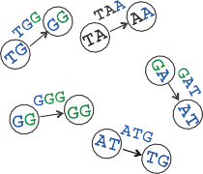
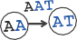
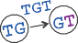
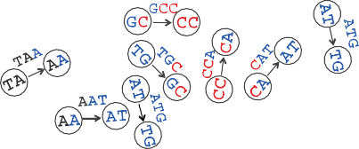
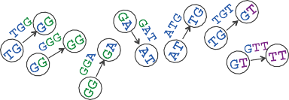
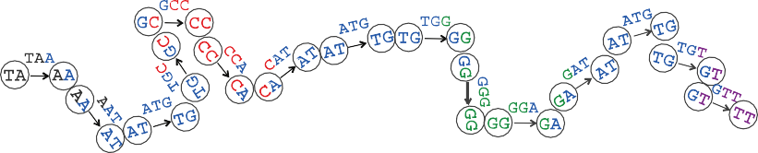

Slide 20
Constructing De- Bruijin Graphs from k-mer composition
Given a collection of k-mer patterns ,the nodes of DEBRUIJINk(Patterns) are simply all unique (k-1)- mers occurring as a prefix or suffix of 3-mers in Patterns.
Lets suppose we are given the following collection of 3-mers :
Then the set of eleven unique 2-mers occurring as prefix or suffix in this collection is as follows
For every k-mer patterns, we connect its prefix node to its suffix node by a directed edge in order to produce DEBRUIJIN(Patterns)

Slide 21
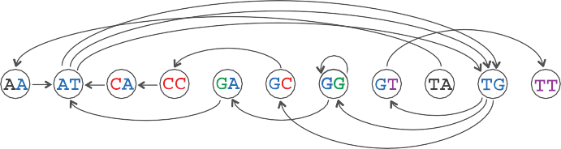
De-Bruijin graphs from its k-mer composition Input : An integer k and a collection Patterns of k-mers. Output : The de-Bruijn graph ,DEBRUIJIN(Patterns)

Slide 22




SEVEN BRIDGES OF KONNIGSBERG
Nodes represent the four sectors of the city
Edges represent bridges connecting different sectors
The edges are undirected , so they can be traversed either direction
A cycle that traverses each edge of a graph exactly once is called “Eulerian cycle”
Graph that contains Eulerian cycle is “Eulerian”
Not Eulerian

Slide 23
Euler's Theorem
Balanced : Number of incoming edges at any node = number of outgoing edges at that node i.e. , IN(v) =OUT(v)
Strongly connected : If its possible to reach any node from every other node
Euler’s theorem : Every balanced , strongly connected graph is Eulerian

Slide 24
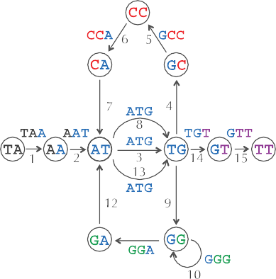
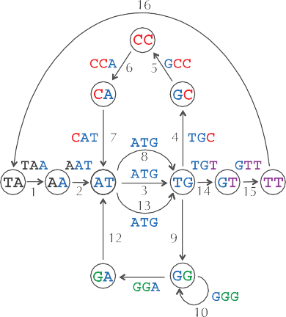
From Eulerian path to Eulerian cycle
We can transform a Eulerian path into Eulerian cycle by adding a single edge connecting the semi balanced nodes (Here TT and TA)
Thus, a nearly balanced graph has an Eulerian path if and only if adding an edge between its unbalanced nodes makes the graph balanced and strongly connected

Slide 25
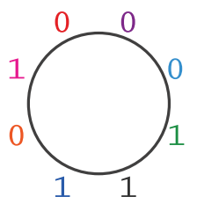
Universal Strings
K-Universal circular string problem requires us to reconstruct a circular string given its k-mer composition
This problem models the assembly of a circular genome containing a single chromosome, like the genomes of most bacteria.
We can reconstruct a circular string from its k-mer composition by finding a Eulerian cycle in the de Bruijn graph constructed from these k- mers

Slide 26
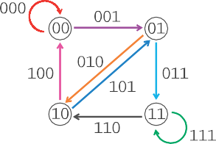
The nodes represent all the possible binary (k-1)mers . A directed edge connects (k-1)-mer patterns to (k-1) mer pattern’
Gluing identically labelled nodes in the top graph results in a de Bruijn graph containing four nodes . A Eulerian cycle through the edges 000→001→011→111→110→101→010→100→000 yields the 3-universal circular strings 00011101

Slide 27
Another Example
A procedure for making a De Bruijn graph for a genome
Assume perfect sequencing where each length-k substring is sequenced exactly once with no errors
Pick a substring length k: 5
Start with an input string: a_long_long_long_time
Take each k -mer and split into left and right k-1 mers long_
long ong_

Slide 28
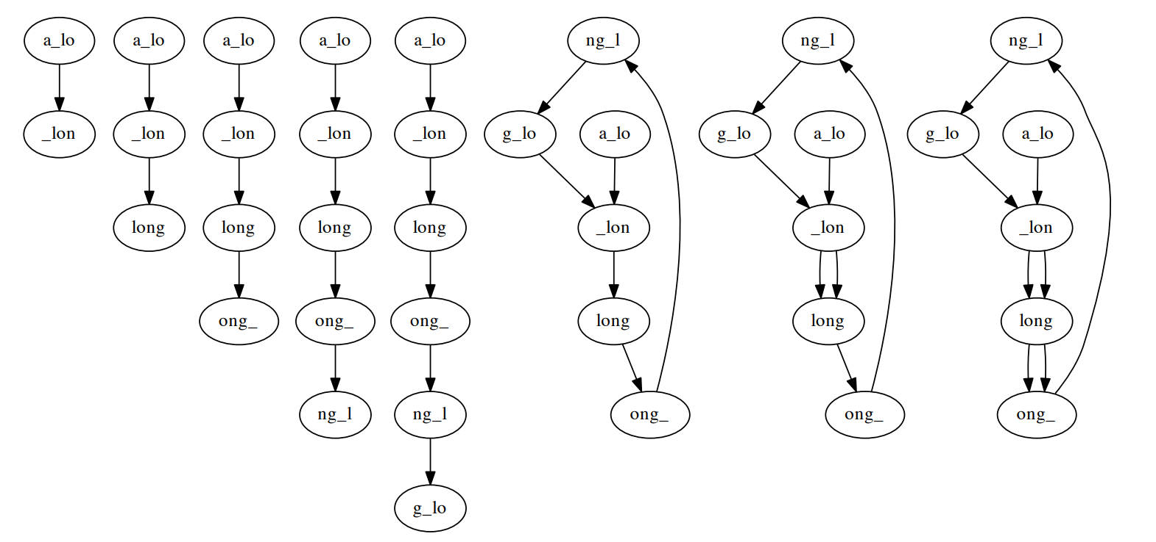
First 8 k-mer additions, k = 5 a_long_long_long_time

Slide 29
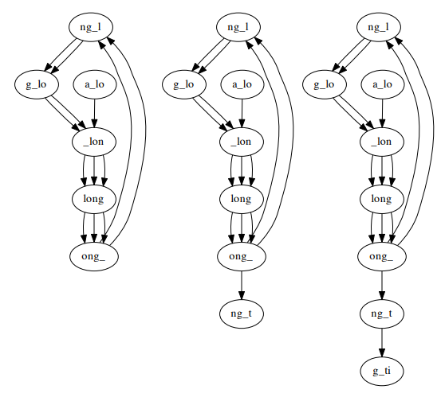
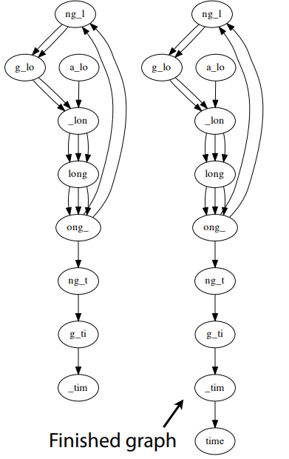
Last 5 k-mer additions, k = 5
a_long_long_long_time

Slide 30
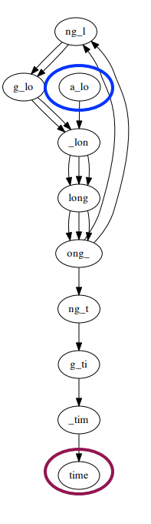
Node for k-1-mer from left end is semi-balanced with one more outgoing edge than incoming
Node for k-1-mer at right end is semi-balanced with one more incoming than outgoing
Other nodes are balanced since # times k-1-mer occurs as a left k-1-mer = # times it occurs as a right k-1-mer
For Eulerian graph, Eulerian walk can be found in O(| E |) time. | E | is # edges

Slide 31
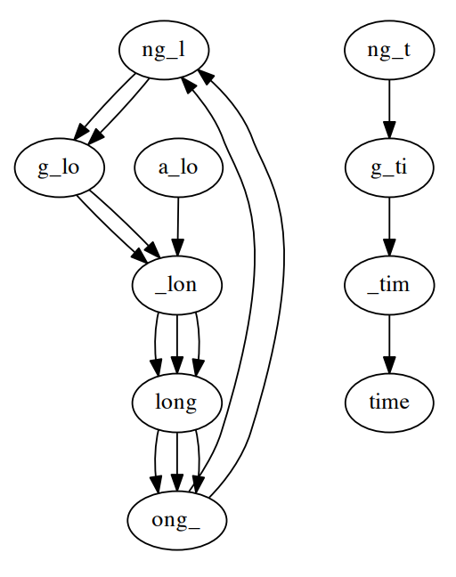
Gaps in coverage can lead to disconnected graph
Graph for a_long_long_long_time, k = 5 but omitting ong_t :
disconnected components are individually Eulerian, overall graph is not

Slide 32
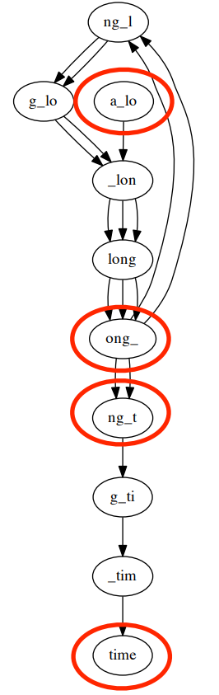
Differences in coverage also lead to non Eulerian graph
Graph for a_long_long_long_time, k = 5
but with extra copy of ong_t :
Graph has 4 semi-balanced nodes, isn’t Eulerian
Errors and differences between chromosomes also lead to non-Eulerian graphs

Slide 33
Genome assembly faces real sequencing data
Breaking reads into k-mers
Coverage : Number of reads to which the k-mer belongs to
We have taken for granted that a sequencing machine can generate all the k-mers present in the genome , but this assumption doesn’t hold in practice
Read breaking: Breaking the reads into shorter k-mers
Read breaking technique is used by many modern assemblers

Slide 34
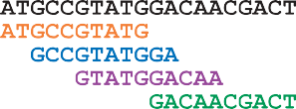
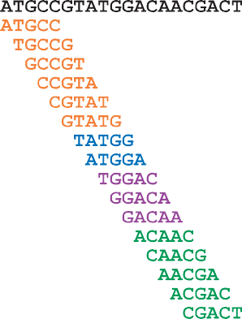
Breaking a 10-mer reads(left) into 5-mer results in perfect coverage of a genome by a 5-mer (right)
Smaller the value of k , the larger the chances that k-mer coverage is perfect on the other hand, smaller values of k results in a more tangled de-bruijn graphs , making it difficult to infer the genome from this graph

Slide 35
Key points
Hamiltonian path problem is an NP complete problem
All NP complete problems are equivalent to each other : an instance of any NP-complete problem can be transformed into instance of other NP- complete problem in polynomial time
Eulers algorithm is polynomial
An algorithm is polynomial if its running time can be bounded by a polynomial in the length of the input data

Slide 36
From reads to read - pairs

Slide 37
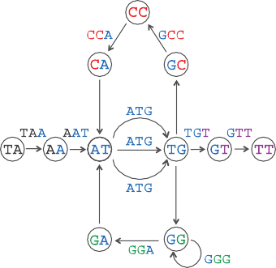
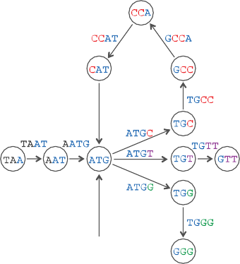

De bruijn graphs becomes less and less tangled as read length increases
As soon as the read-length exceeds the length of all repeats in genome ,the de bruijn graphs turn into a path
The graph in the right is less –tangled than the graph in the left

Slide 38
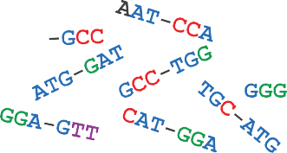

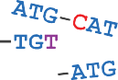
Read pairs : Pairs of reads separated by a fixed distance d in the genome
It is an indirect way of increasing read length
It is a long gapped read of length k + d-k whose first and last k-mers are known but whose middle segment of length d is unknown
Read pairs contain more information than k-mers alone
Read-pairs sampled from TAATGCCATGGGATGTT and formed by reads of length 3 separated by a gap of length 1

Slide 39
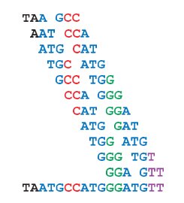
From composition to paired composition
Given a string, Text, a (k , d)-mer is a pair of k-mers in Text separated by distance d .We use the notation (Pattern 1| Pattern 2) to refer to a (k , d)-mer whose k-mers are Pattern 1; and Pattern 2. For example, (ATG | GGG) is a (3,4)-mer in TAATGCCATGGGATGTT. The(k , d)-mer composition of Text, denoted PAIREDCOMPOSITION, k , d(Text), is the collection of all (k , d)-mers in Text (including repeated (k ,d)-mers). For example, here is
PAIREDCOMPOSITION3 ,1 (TAATGCCATGGGATGTT)

Slide 40
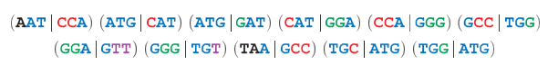
Since the order of (3,1)-mers in PAIREDCOMPOSITION(TAATGCCATGGGATGTT) is unknown , we list them according to the lexicographical order
Note that there are repeated k-mers in its 3-mer composition but there are no repeated k-mers in its (3,1) –mer composition
String Reconstruction from Read-Pairs Problem:
Reconstruct a string from its paired composition
Input : A collection of paired k-mers PairedReads and an integer d
Output: A string Text with (k , d)-mer composition equal to PairedReads (if such a string exists).

Slide 41
Paired de bruijn graphs
Given a (k , d)-mer (a1….ak| b1…bk), we define its prefix and suffix as the following,(k—1,d+ 1)-mers :
PREFIX((a1….ak| b1…bk )) = (a1….ak-1| b1…bk-1)
SUFFIX(((a1….ak| b1…bk)) = (a2….ak| b2…bk)
For example, PREFIX((GAC | TCA)) = (GA| TC) and SUFFIX ((GAC | TCA)) = (AC | CA).
Note that for consecutive (k,d)-mers appearing in Text, the suffix of the first (k,d)-mer is equal to the prefix of the second (k,d)-mer.
For example, for the consecutive(k,d)-mers (TAA | GCC) and (AAT | CCA) in
TAATGCCATGGGATGTT,SUFFIX((TAA|GCC)) = PREFIX((AAT | CCA) ) = (AA|CC)

Slide 42
We label edges in this path by(k,d) –mers and label the starting and ending nodes of an edge by its prefix and suffix respectively
‘The paired de Bruijn graph, denoted DEBRUIJN k,d( Text), is formed by gluing identically labelled nodes in PATHGRAPH k,d(Text). Note that the paired de Bruijn graph is less tangled than the de Bruijn graph constructed from individual reads.

Slide 43
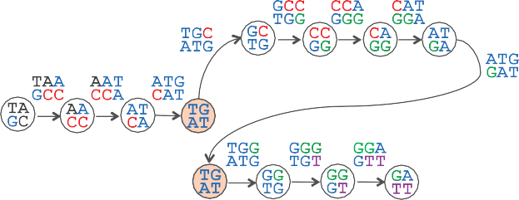
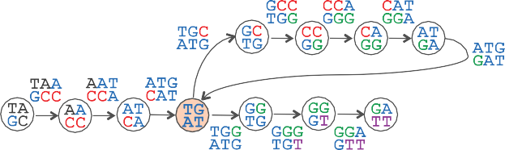
PATHGRAPH 3,1(TAATGCCATGGGATGTT) is formed by eleven edges and twelve nodes. Only two of these nodes have the same label, (TG | AT).(Middle) Bringing the two identically labelled nodes closer to each other in preparation for gluing.(Bottom) The paired de Bruijn graph DEBRUIJN3,1 (TAATGCCATGGGATGTT) is obtained from PAIHGRAPH 3,1(TAATGCCATGGGATGTT) by gluing the nodes sharing the label (TG | AT). This paired de Bruijn graph has a unique Eulerian path, which spells out TAATGCCATGGGATGTT.

Slide 44
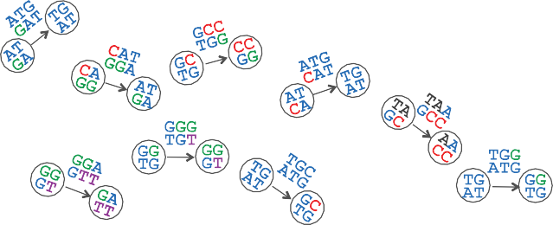
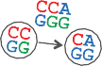
The graph COMPOSITIONGRAPH 3,1(TAATGCCATGGGATGTT) is a collection of isolated edges. Each edge is labelled by a (3,1)-mer_ in TAATGCCATGGGATGTT; the starting node of an edge is labelled by the prefix of the edge’s (3, 1)-mer, and the ending node of an edge is labelled by the suffix of this(3, 1)-mer. Gluing identically labelled nodes yields the paired de Bruijn graph shown

Slide 45
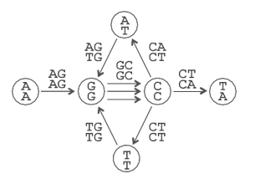
A paired de bruijn graph constructed from (2,1) mers

Slide 46
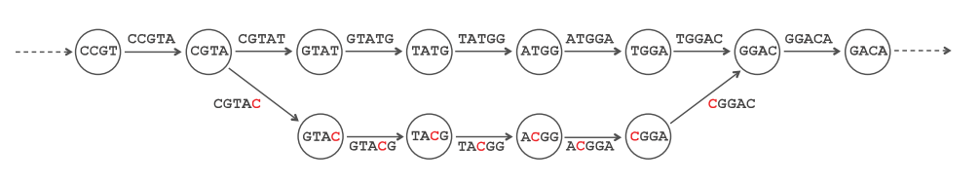
Assembling Error prone reads
Error-prone reads represent yet another barrier for real –sequencing data
Adding single erroneous read CGTACGGACA (with a single error that misleads T as C) to the set of reads results in erroneous 5 mers CGTAC,GTACG,TACGG,ACGGA, and CGGAC after read breaking
This structure is called bubble , which we define as two short disjoint paths connecting the same pair of nodes in the de Bruijn graph

Slide 47
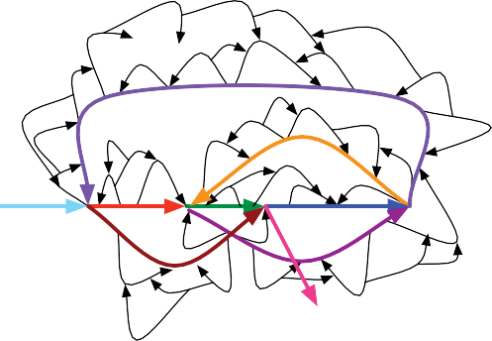
An illustration of a de Bruijn graph with many bubbles. Bubble removal should leave only the colored paths remaining

Slide 48
Implementation

Slide 49


To start, we need to extract the 3mers from the sequence. The function below will return a dictionary object where the keys include all observed k mers in the input alphabet, and the values represent the number of times that k mer was observed in the input sequence

Slide 50

Build the De Bruijn Graph
Here we will use a set of tuples to store pairs of (k-1)mers representing an edge.
We can construct a graph connecting (k-1)mers as nodes using the code below. This compares all k mers to each other, if the n-1 suffix of one matches the n-1 prefix on another (i.e., they overlap) then the pair (which together form a k mer) is stored as an edge in the graph

Slide 51

Binary Sequence - 1

Slide 52

Plotting the graph
The function below uses the Python library toyplot to generate a graph from a set of edges. It uses a force-directed algorithm to randomly space the nodes to make it easy to read.
The edges of the graph are shown with arrows which indicates the direction.
The function below itself simply takes the edge information we generated and a number of styling options for the plot.

Slide 53



Slide 54
Comparing both the graphs
Both are having 4 nodes(00,01,11,10) and 2 edges

Slide 55

Binary Sequence - 2

Slide 56
Plotting the graph
The function below uses the Python library toyplot to generate a graph from a set of edges. It uses a force-directed algorithm to randomly space the nodes to make it easy to read.
The edges of the graph are shown with arrows which indicates the direction.
The function below itself simply takes the edge information we generated and a number of styling options for the plot.

Slide 57


K-universal binary string

Slide 58
Example with Sequence data

Slide 59


Lets generate some randomly selected data as our sequence
Randomly generated genome of length 25

Slide 60

K-mers of our sequence

Slide 61

Edges for sequence data

Slide 62

Graph for k=6
Let's put these functions all together to infer a de Bruijn graph and plot it for a sequence using k mers of size=6

Slide 63

We can see that there is only one path that connects every node in the graph. This path spells out the genome sequence. In other words, we assembled the genome from its k mers!

Slide 64

Graph for k=6 (acyclic)
We can run the same code as above but this time we provide the function get_kmer_count_from_sequence with the argument cyclic=False

Slide 65

This is more realistic for a linear chromosome, rather than circular one

Slide 66

Graph for k=4
The real world of genome assembly is much more difficult than the one we've seen so far. One reason for this is that given the k mer size that we choose, which is often a limitation imposed by the short read datatype, there may be too much repetition of edges connecting the same k mers such that there is not a single unique Eulerian path through the graph.

Slide 67

we can see that a few nodes have multiple edges coming in or out. In this case, because each internal edge has the same number of edges coming in as out, it still actually forms a Eulerian path! However, it is ambiguous to us which way through the path is the true one. These loops in the path are called bubbles, and genome assembly software is optimized to try to solve them

Slide 68
Thank you

